Slide 1


Digital Freelancer:
Managing Freelancing Projects
Project: Working with a Mock Client

Slide 2
Part 1
Project Listing

Slide 3
Project Listing : Data Analyst
Seeking experienced Data Analyst to build dashboard for local insurance company.
Posted 1 week ago
Hourly: $90.00 Based on experience.
Project Time: 1 year, 20 hours a week.
Project Description:
I have taken over a local car insurance company from my parents and have inherited hundreds of Excel spreadsheets with past and current customer information. I need help organizing this data and creating a dashboard to allow me to filter the data and create reports as needed. I would also need guidance on how to transfer the data to the tool of your choice. Looking forward to working together!

Slide 4
Part 2
Expression of Interest

Slide 5
Expression of Interest
Which Sample Project Listing did you select to respond to?
Answer: Seeking experienced Data Analyst to build dashboard for local insurance company.
Expression of Interest:Hello, looks like you need to organize customers data and make dashboards to filter and control the data I’d recommend using power bi it is a tool by Microsoft used to load the data from different resources easily and make transformation steps (cleaning, preprocessing) also we can use it to make dashboards to filter the data and create reports as needed .it will help you to develop the company and increase sales percentage after seeing the visualization you can find guidance on how to transfer the data from your company to the tool. i want to inform you that this application will be easier to work with and this will meet your specifications, i would like to tell you that i understand what you want to do in the project and i will do my best to make a readable dashboards and reports that help you in your company , i will be so glad to work with you I’ve 2-years experience working in analyst field I have dealt with huge data with different resources , created a lot of dashboards and reports using the tool mentioned you can check my portfolio for past experiences. Let me know if you’d like to chat

Slide 6
Part 3
Project Management Process

Slide 7
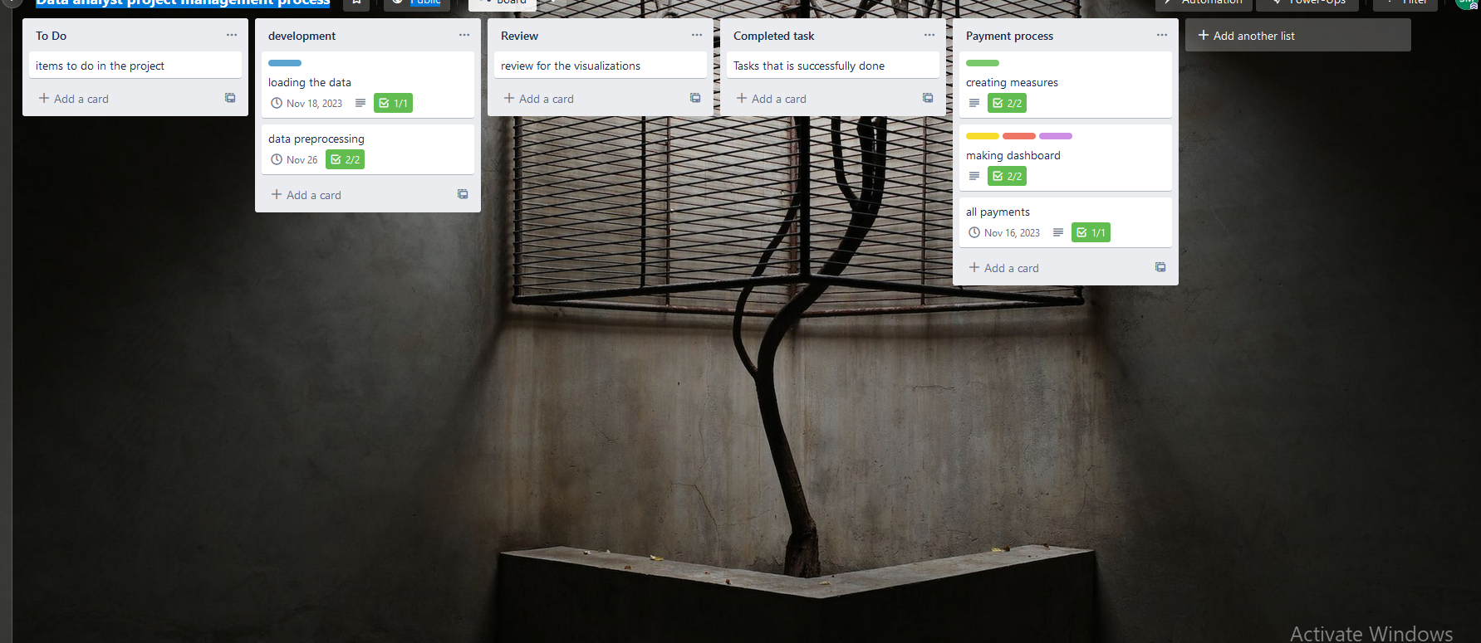
Trello Board
A link to your public Trello board should be provided here:
[https://trello.com/b/vd0O4R86/data-analyst-project-management-process]
Include a screenshot of the board below:
Paste screenshot here

Slide 8
Part 4
Invoice and Payment Options

Slide 9
[seif mahmoud]
[cairo,egypt]
Invoice
Recipient:
[local car insurance company ]
[Cairo/egypt]
Invoice #: [1243787]
Date issued: [11/14/2022]
Date due: [11/14/2023]
Service | Description of Work Done | Hours Spent | Amount Per Hour | Total
Collecting data and understand t | Understanding the data | 10 hrs | [90$] | (Hours spent) x (Amount per hour) = [900$]
[reading the data to the tool] | Loading the data to the tool | 20 hrs | [90X] | (Hours spent) x (Amount per hour) = [1800$]
Data transformation | Data transformation and cleaning | 40 hrs | [90X] | (Hours spent) x (Amount per hour) = [3600$]
Data Visualization | Making dashboards for different sections | 30 hrs | [90X] | (Hours spent) x (Amount per hour) = [2700$]
Total Payment Due: [9000$]
Payment Options: Bank account:
90th street, New cairo, Cairo Governorate
Account Number : 0000000XXXX

